Slide 1
Cohen chap 9. Linear Correlation
"Statistics is not a discipline like physics, chemistry, or biology where we study a subject to solve problems in the same subject.
We study statistics with the main aim of solving problems in other disciplines.”
C.R. Rao, Ph.D.
For EDUC/PSY 6600

Slide 2
Motivating example
Dr. Mortimer is interested in knowing whether people who have a positive view of themselves in one aspect of their lives also tend to have a positive view of themselves in other aspects of their lives.
He has 80 men complete a self-concept inventory that contains 5 scales. Four scales involve questions about how competent respondents feel in the areas of intimate relationships, relationships with friends, common sense reasoning and everyday knowledge, and academic reasoning and scholarly knowledge.
The 5th scale includes items about how competent a person feels in general.
10 correlations are computed between all possible pairs of variables.

Slide 3
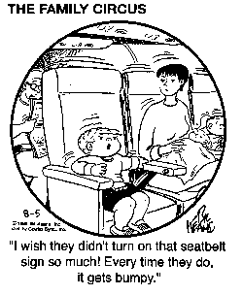
Correlation
Interested in degree of covariation or co-relation among >1 variables measured on SAME objects/participants
Not interested in group differences, per se
Variable measurements have
Order: Correlation
No order: Association or dependence
Level of measurement for each variable determines type of correlation coefficient
Data can be in raw or standardized format
Correlation coefficient is scale-invariant
Statistical significance of correlation?
H₀: population correlation coefficient = 0

Slide 4
Scatterplots
ALWAYS VISUALIZE DATA 1st
Scatterplots, scatterdiagrams, or scattergrams
Can stratify scatterplots by subgroups
Each subject is represented by 1 dot
(x and y coordinate)
Fit line can indicate nature
and degree of relationship
Regression or prediction lines

Slide 5
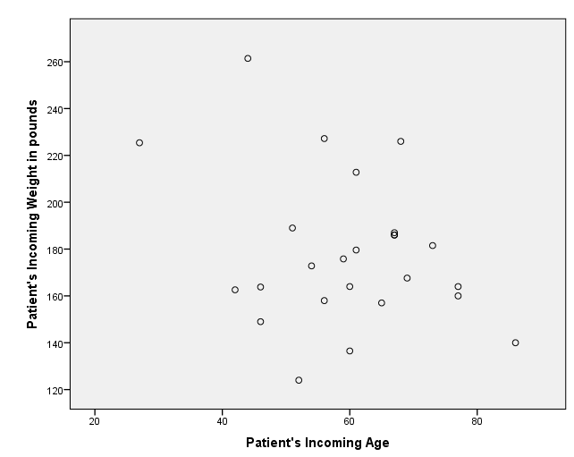
SPSS: basic scatterplot

Slide 6
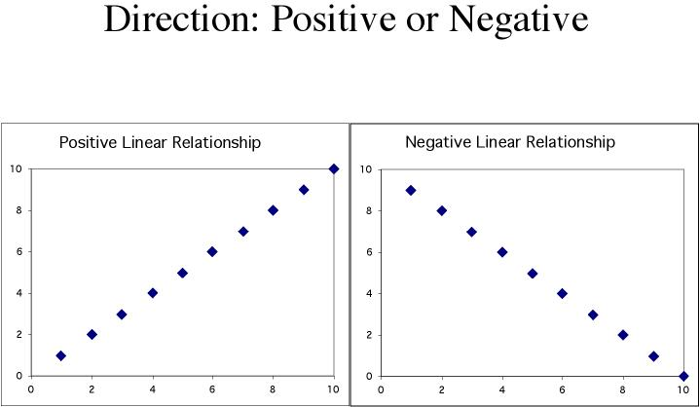
Correlation: Direction
Positive association:
High values of one variable
tend to
occur together with
High values of the other variable
Negative association:
High values of one variable
tend to
occur together with
Low values of the other variable

Slide 7
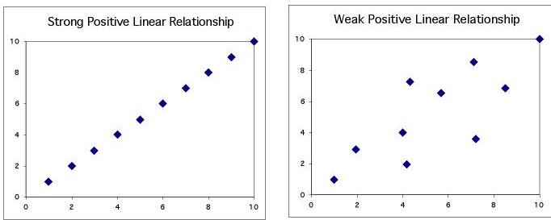
Correlation: strength
The strength of the relationship between the two variables can be seen by how much variation, or scatter, there is around the main form.
With a strong relationship, you can get a pretty good estimate of y if you know x.
With a weak relationship, for any x you might get a wide range of y values.

Slide 8
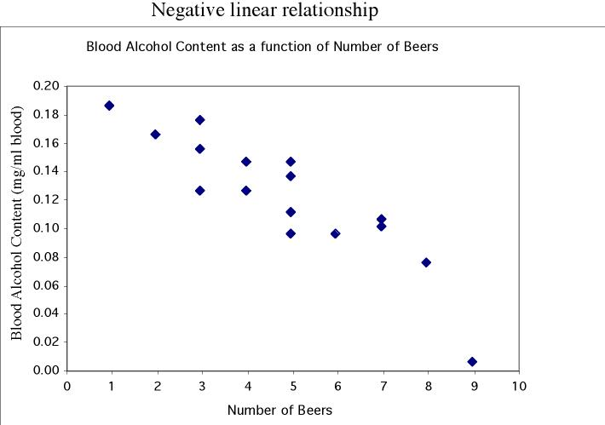
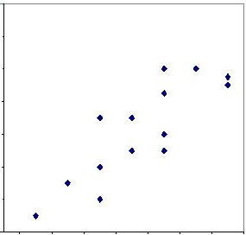
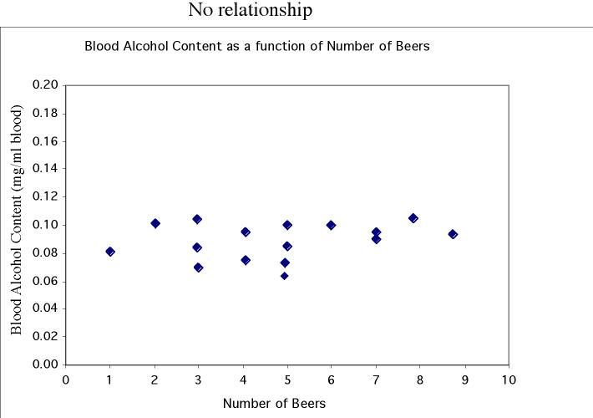
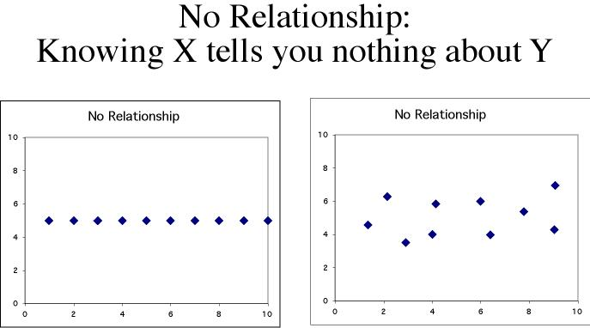
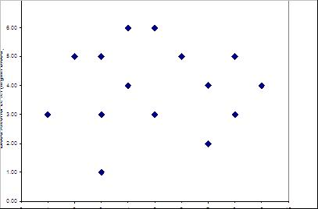
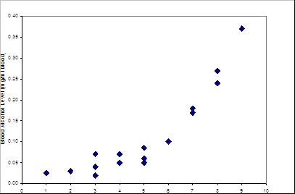
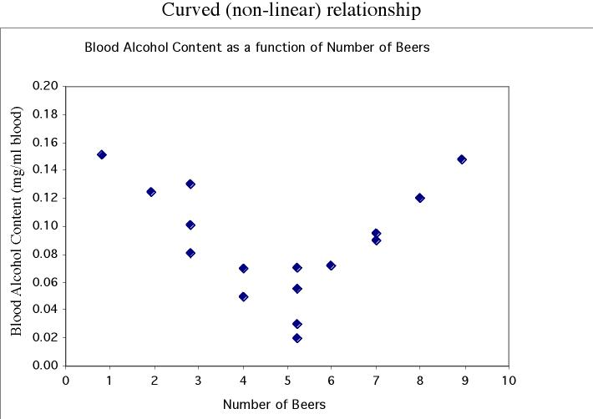
Scatterplot patterns
No relationship:
X and Y vary independently.
Knowing X tells you nothing about Y.
Linear
Nonlinear

Slide 9
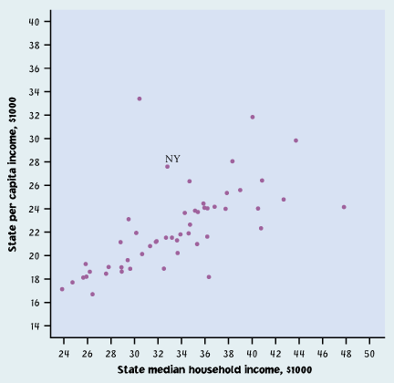
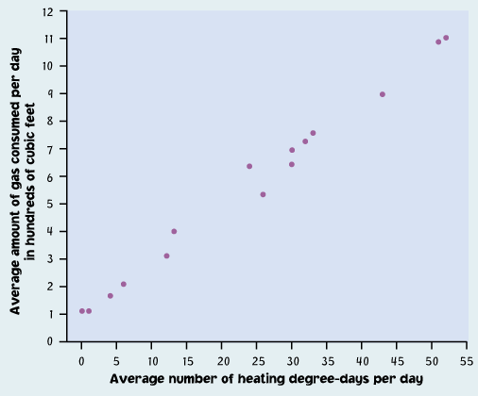
Correlation: examples
This is a weak relationship.
For a particular state median household income, you can’t predict the state per capita income very well.
This is a very strong relationship.
The daily amount of gas consumed can be predicted quite accurately for a given temperature value.

Slide 10
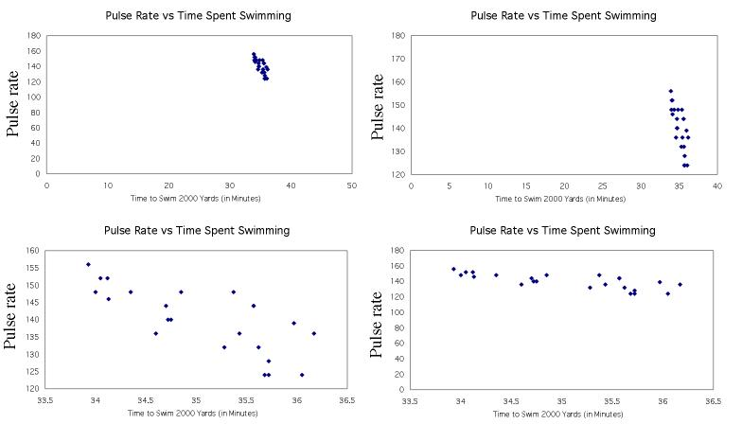
Scatterplot: scale
Same data in all four plots
Using an inappropriate scale for a scatterplot can give an incorrect impression.
Both variables should be given a similar amount of space:
Plot roughly square
Points should occupy all the plot space (no blank space)

Slide 11
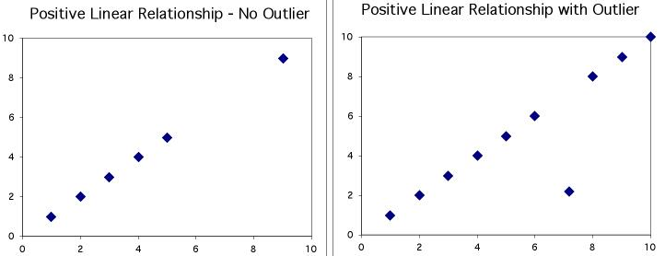
outliers
An outlier is a data value that has a very low probability of occurrence (i.e., it is unusual or unexpected).
In a scatterplot, BIVARIATE outliers are points that fall outside of the overall pattern of the relationship.
Not all extreme values are outliers.

Slide 12
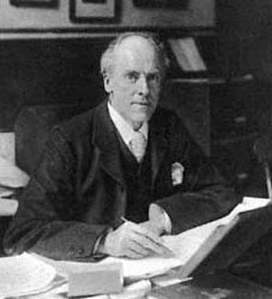
Pearson “Product Moment” Correlation Coefficient (r)
Used as a measure of
Magnitude (strength) and direction of relationship between two continuous variables
Degree to which coordinates cluster around STRAIGHT regression line
Test-retest, alternative forms, and split half reliability
Building block for many other statistical methods
Population: ρ (rho)
Sample: r

Slide 13
Pearson “Product Moment” Correlation Coefficient (r)
The correlation coefficient is a measure of the direction and strength of a linear relationship.
It is calculated using the mean and the standard deviation of both the x and y variables.
Correlation can only be used to describe quantitative variables.
Categorical variables don’t have means and standard deviations.
r does not distinguish between x and y
r has no units of measurement
r ranges from -1 to +1
Influential points…can change ‘r’ a great deal!

Slide 14

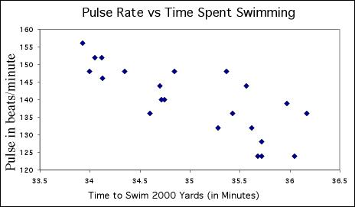
Correlation: calculating
Time to swim: x-bar = 35, s_{x} = 0.7
Pulse rate: x-bar = 140 s_{y} = 9.5
How to find “r”?
You DON'T want to do this by hand!
Make sure you learn how to use your calculator or software.

Slide 15
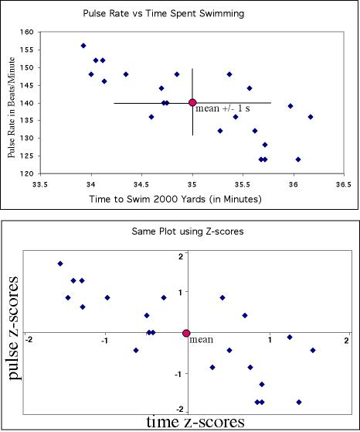
Correlation: calculating
Standardization:
Allows us to compare correlations between data sets where variables are measured in different units or when variables are different.
For instance, we might want to compare the correlation between [swim time and pulse], with the correlation between [swim time and breathing rate].

Slide 16
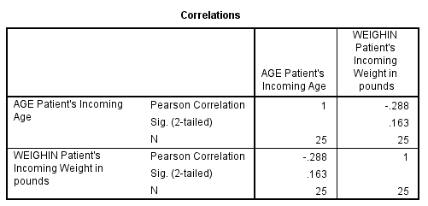

SPSS: correlation - basic

Slide 17
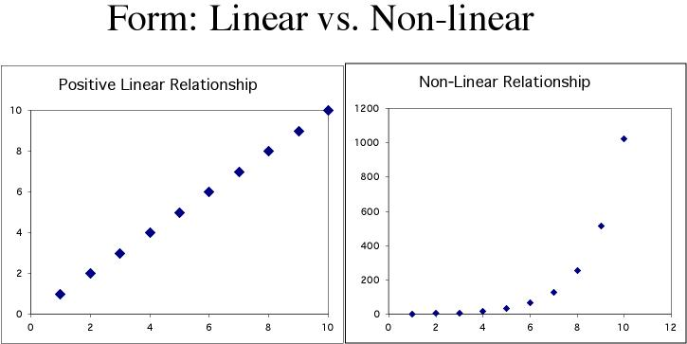
Correlation: relationship form
Correlation only describes linear relationships
No matter how strong the association, r does not describe curved relationships.
Note: You can sometimes transform a non-linear association to a linear form, for instance by taking the logarithm. You can then calculate a correlation using the transformed data.

Slide 18
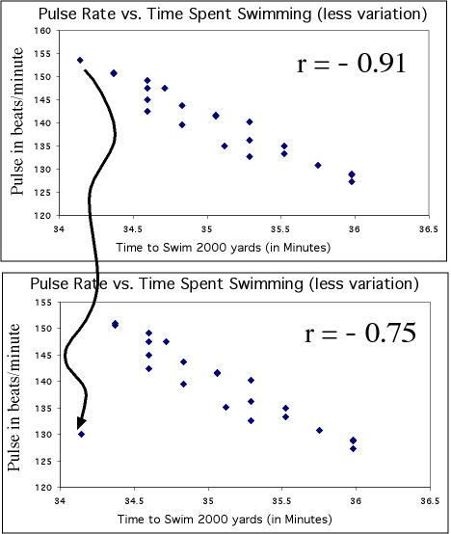
Correlation: influential points
Correlations are calculated using means and standard deviations, and thus are NOT resistant to outliers.
Just moving one point away from the general trend here decreases the correlation from -0.91 to -0.75

Slide 19
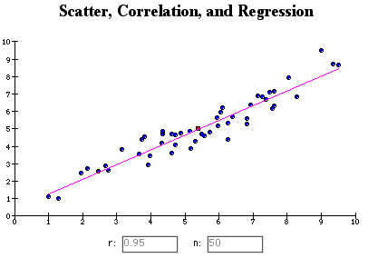
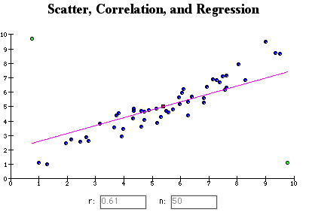
Correlation: influential points
http://digitalfirst.bfwpub.com/stats_applet/stats_applet_5_correg.html
Adding two outliers decreases r from 0.95 to 0.61.

Slide 20
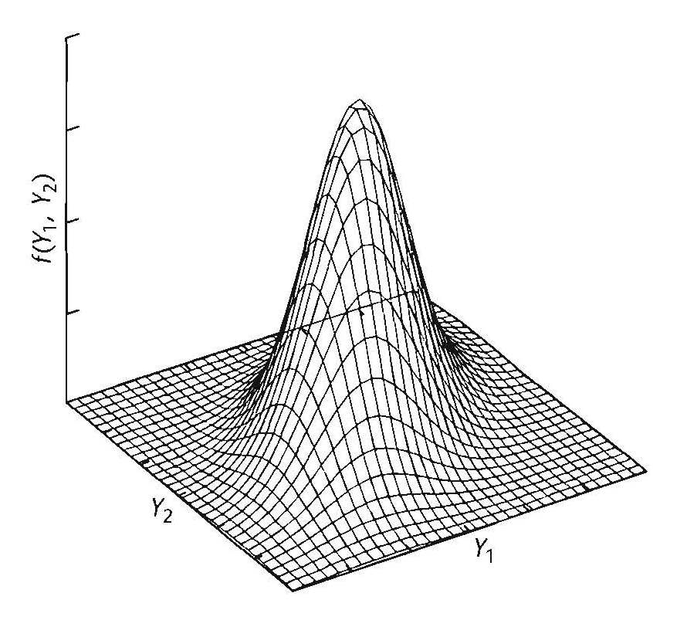
assumptions
Random sample
Relationship between variables is linear
Check scatterplot
Transform data or use alternative methods
Bivariate normal distribution
Each variable should be normally distributed in population
Joint distribution should be bivariate normal
Curvilinear relationships = violation
Less important as N increases

Slide 21
Sampling Distribution of “Rho”
Normal distribution about 0
Becomes non-normal as ρ gets larger and deviates from H₀ value of 0 in the population
Negatively skewed with large, positive null hypothesized ρ
Positively skewed with large, negative null hypothesized ρ
Leads to
Inaccurate p-values
No longer testing H₀ that ρ = 0
Fisher’s solution: transform sample r coefficients to yield normal sampling distribution, regardless of ρ
We will let the computer worry about the details…

Slide 22
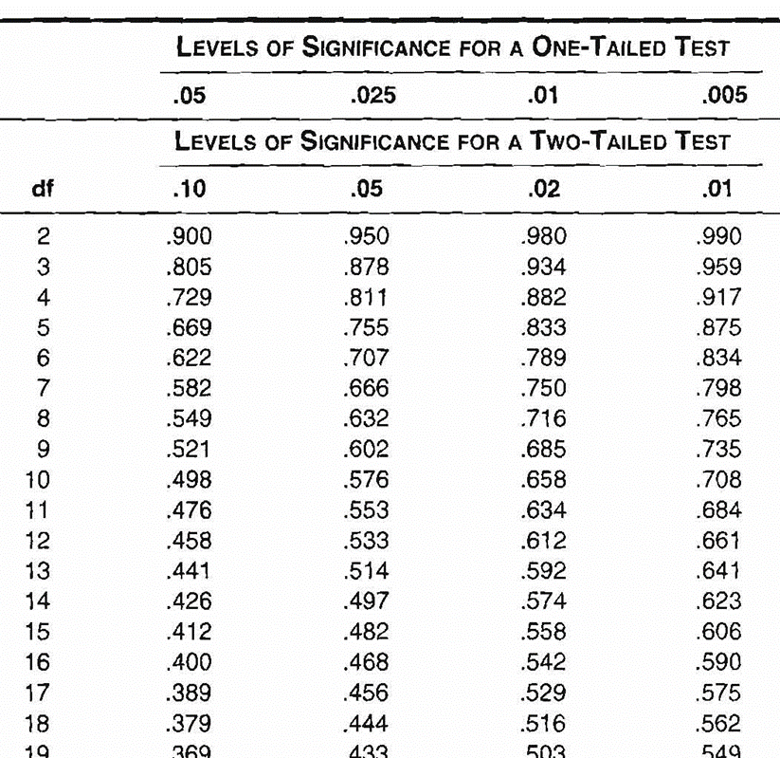
HYPOTHESIS TESTING FOR 1-SAMPLE “R”
H₀: ρ = 0
H₁: ρ ≠ 0 (2-tailed)
r converted into t-statistic
No r transformation as ρ is at center (0)
Compare to t-distribution with df = N – 2
Rejection: statistical evidence for co-relationship
Or, see table of critical values for r

Slide 23
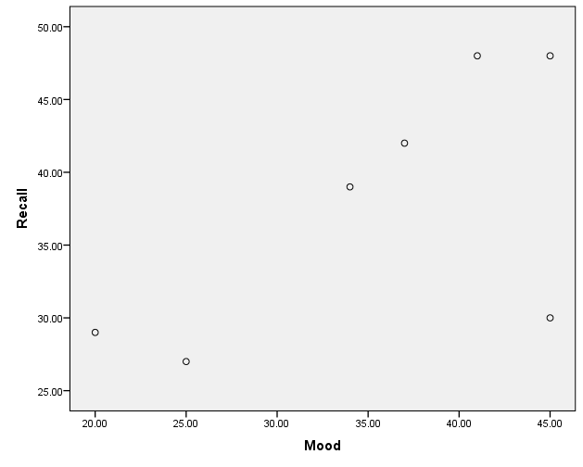

eXAMPLE
Mood Recall
45 48
34 39
41 48
25 27
38 42
20 29
45 30
Researcher wishes to correlate scores from 2 tests: current mood state and verbal recall memory
Compute r, test for significance (H₀: ρ = 0), construct 95% CI

Slide 24


POWER
N necessary to reject H₀ given an effect ρ
Determine d (value of ρ [or r ] to detect as significant)
Determine delta (δ) (value from appendix A.4 that would result in given level of power at α = .05)
Solve:
Example: Chap9A #8
A college admissions officer is tracking the relationship between students’ verbal SAT scores and their first-year grade point average (GPA).
Based on this pilot data, how many students should I plan to study to ensure I have at least 95% power for an alpha = .01, one-tailed test?
Verbal SAT | GPA
510 | 2.1
620 | 3.8
400 | 2.2
480 | 3.1
580 | 3.9
430 | 2.4
530 | 3.6
680 | 3.5
420 | 3.3
570 | 3.4
1) “d” = “r” = .661
2) “delta” = 3.97
3) N = (3.97/.661)^2 + 1 = 37.07
They would need at least 38 students.

Slide 25
Factors Affecting Validity of r
Range restriction (variance of X and/or Y)
r can be inflated or deflated
May be related to small N
Outliers
r can be heavily influenced
Use of heterogeneous subsamples
Combining data from heterogeneous groups can inflate correlation coefficient or yield spurious results by stretching out data

Slide 26
Interpretation & Communication
Correlation ≠ Causation
Can infer strength and direction; not form or prediction from r
Can say that prediction will be better with large r, but cannot predict actual values
Statistical significance
p-value heavily influenced by N
Need to interpret size of r-statistic, more than p-value
APA format
r(18) = -.74, p < .01

Slide 27
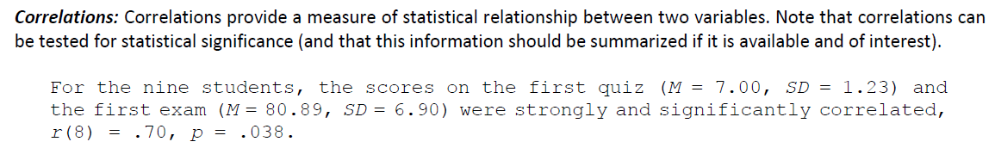
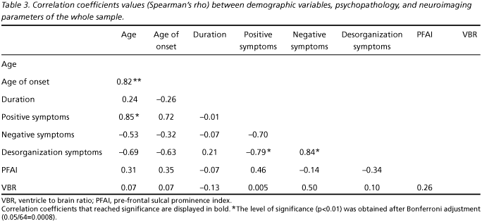
APA style reporting
“A Pearson product-moment correlation coefficient was computed to assess the relationship between the amount of water that one consumed and rating of skin elasticity. There was a positive correlation between the two variables, r(5) = 0.985, p = 0.002. A scatterplot summarizes the results (Figure 1) Overall, there was a strong, positive correlation between water consumption and skin elasticity. Increases in water consumption were correlated with increases in rating of skin elasticity.”

Slide 28
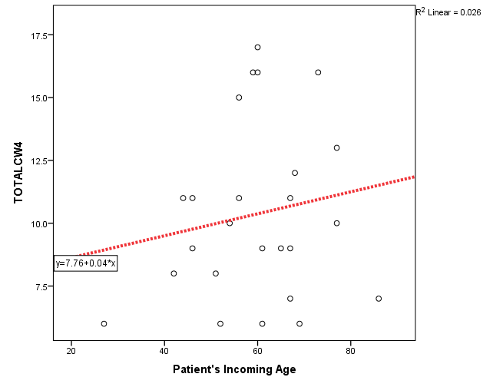
SPSS: scatterplot – add regression line
To add a regression line:
Double-click on the graph in the output window
At the top of the newly opened “chart editor” window with the plot, click the word “Elements” and select the phrase “Fit Line at Total”
The default is a “LINEAR” fit method, so you can click the “Close” button and be done, or you can play with the other options in the various tabs.
When you done making changes, click the Red “x” or “dot” in the upper right corner of the “Chart Editor” to paste your edited plot back in the Output Window.

Slide 29
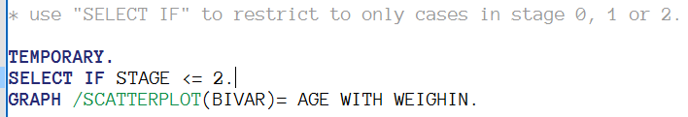
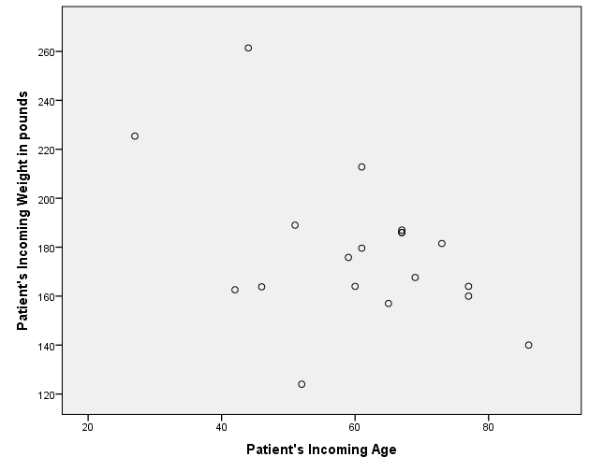
SPSS: scatterplots – select cases

Slide 30
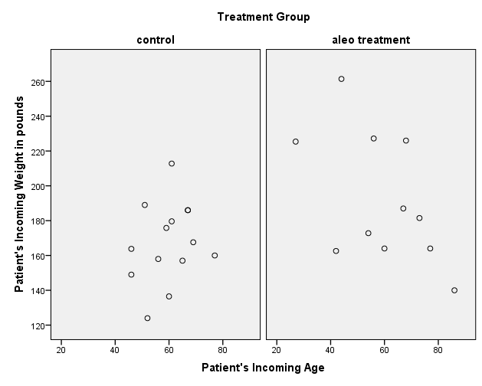
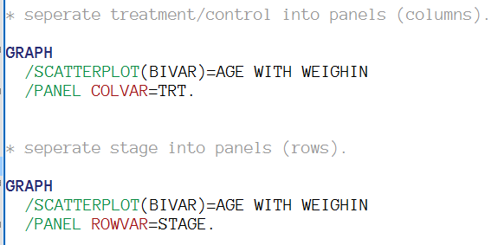
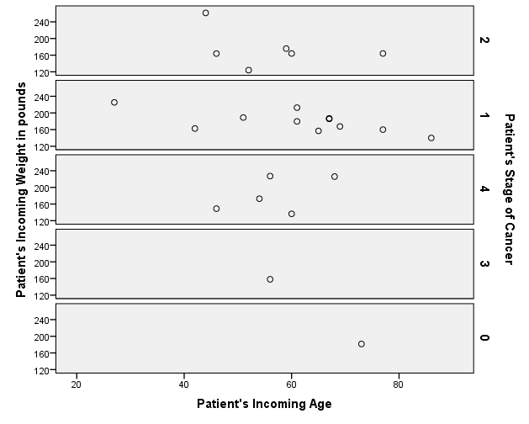
SPSS: scatterplots – panels

Slide 31
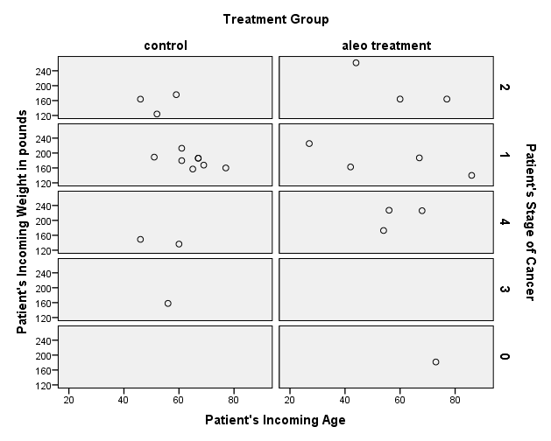
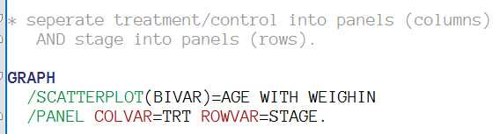
SPSS: scatterplots – panels

Slide 32

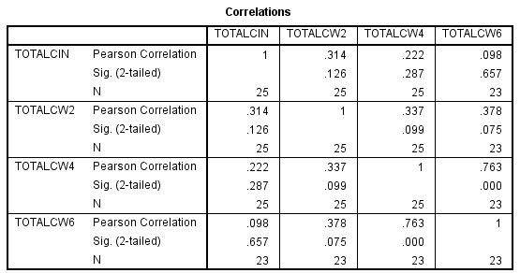
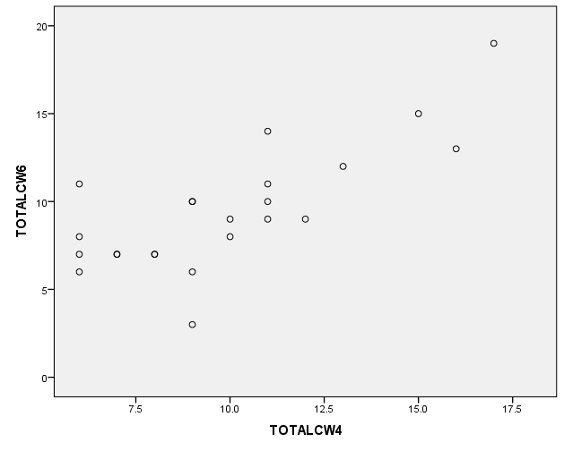
SPSS: correlation – matrix (symmetrical)

Slide 33
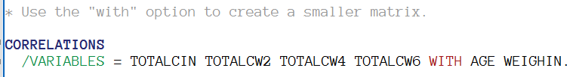
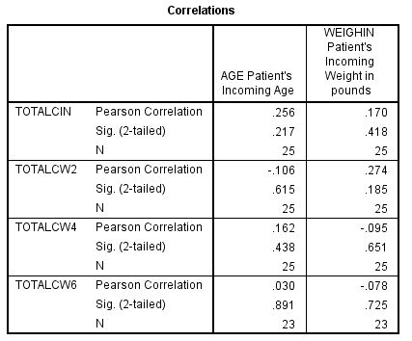
SPSS: correlation – “WITH” option

Slide 34
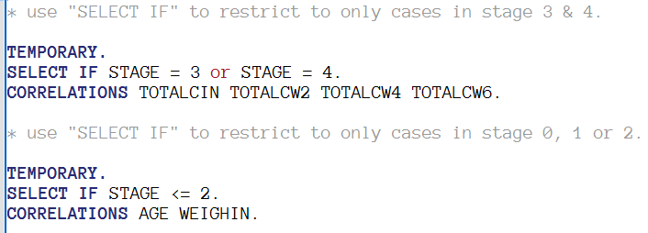
Spss: correlation – w/ “select if”

Slide 35
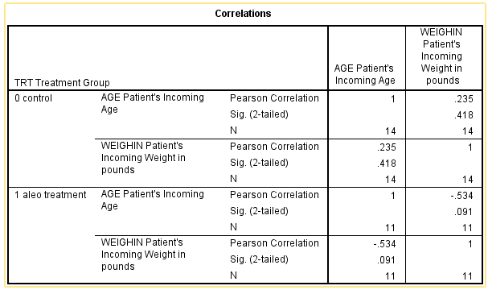
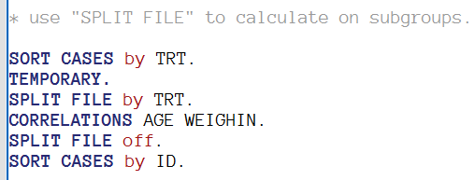
SPSS: correlation – “split file by”

